Slide 1
BLOCKCHAIN as a security IN IOT
Al-Fareed
Manipal Institute of Technology

Slide 2
Contents
What is IoT?
What is Blockchain?
How Blockchain works?
Why Blockchain in IoT?
Drawbacks of Blockchain
Challenges for Blockchain in IoT
Future Works

Slide 3
What is IoT?
The Internet of Things (IoT) describes the network of physical objects—“things”—that are embedded with sensors, software, and other technologies for the purpose of connecting and exchanging data with other devices and systems over the internet.
IoT’s major features are- scalability, connectivity, artificial intelligence, dynamic nature, endpoint management, integration, analyzing, and compact nature of devices.
Challenges of IoT’s are : Security and privacy, Connectivity and power dependence, Integration
Notes:
the capacity to be changed in size or scale.

Slide 4
What is Blockchain Technology
A blockchain is a data structure, which is a growing list of data blocks.
The data blocks are linked together, such that old blocks cannot be removed or altered.
Blockchain technology makes middlemen (so-called trusted third parties) obsolete in many applications.
Blockchain technology has a wide range of applications for consensus building. In a finite timeframe, all participants of the blockchain agree on a proposal, which was worked out by a being participant. At Bitcoin, for example, all participants agree on who owns how many bitcoins. But many applications are also conceivable in industry. As it’s history can be tracked.
If something is published on a public blockchain, all participants become witnesses..

Slide 5
How Blockchain works?
Blockchain works via a multistep process, which in simple terms happens as follows: An authorized participant inputs a transaction, which must be authenticated by the technology. That action creates a block that represents that specific transaction or data. The block is sent to every computer node in the network.
Three parts of chain
Data. The type of data stored in a block differs based on the blockchain. ...
hash. A hash, similar to a fingerprint, is also included in the block. ...
Previous data hash. A hash of a previous block is the final piece in a blockchain.

Slide 6
Blockchain in IoT
In Blockcain IoT systems, the IOT devices uses blockchain technology as the backend networking system for storing their information.
Blockchain in IoT can be implemented in various sectors such as Supplychain management, Agriculture, Automotive Sector or Smart Home
Where it can track the entire process of the supply chain and increase the overall efficiency for better result and securely store user sensitive data such as Face ID, Fingerprints, Voice ID..

Slide 7
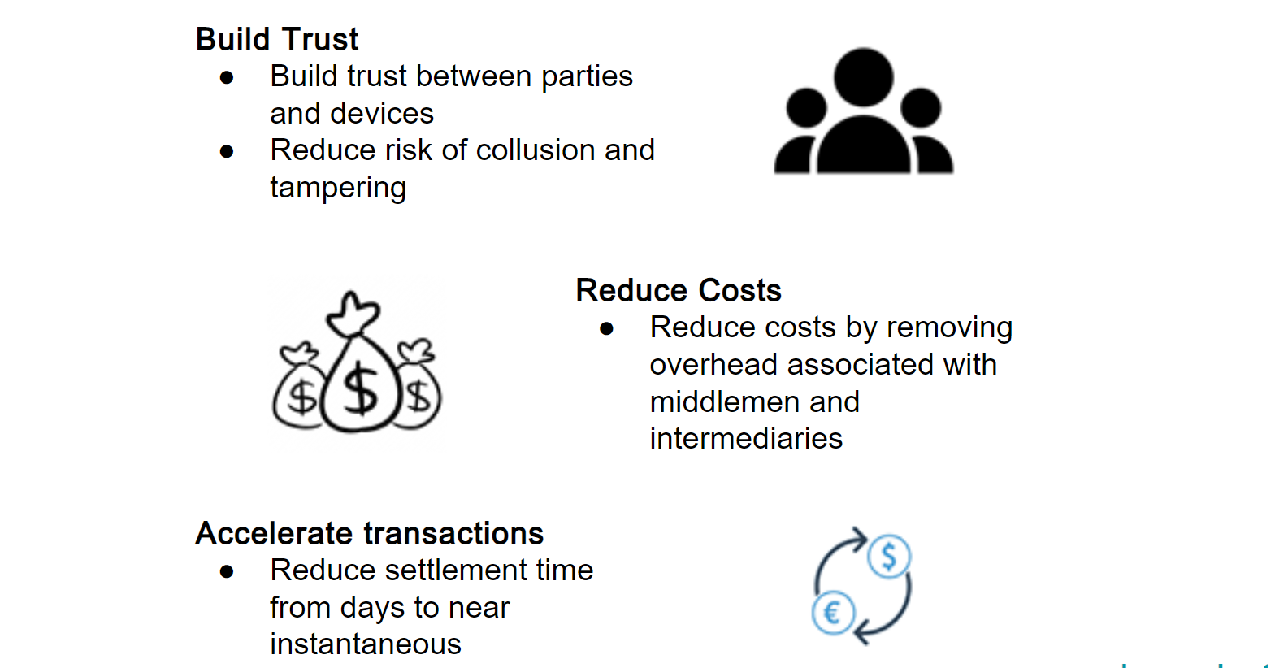
Advantages of Blockchain in IoT

Slide 8
Drawbacks of Blockchain
Challenges
Complex
Slow Speed(Time Consuming)
Wastage of resources
Privacy
51% Attack
Risks such as credential security, Legal and compliance

Slide 9
Future Works
The low consensus efficiency of the current blockchain technology is a problem that will directly impact how quickly an authentication request is processed. The Hyperledger Fabric cluster environment is currently only comprised of a small number of nodes, which reduces the transaction time. The current consensus process, however, is no longer able to satisfy the criteria if it is to be used on a broad scale. Therefore, in order to further increase certification efficiency, the consensus method must be modified.
More tangible tools can be employed in the future to check the system's dependability and throughput.
The members in the alliance chain should be able to amend the smart contract on their own, even though smart contracts might incorporate business logic that is open and challenging to modify. The next phase of study can concentrate on how to implement the self-customization direction while deploying the smart contract to the alliance chain. To enhance this system, future study can strive to create additional smart contracts involving the participants.

Slide 10
Thank you

